Slide 1
Offloading Asynchronous Activities to Lightweight, Short-Lived Functions

Slide 2

The rise of asynchronous processing in microservices
Overview
The problem with the status quo
What serverless computing is about Understanding Spring Cloud Function Creating functions
Understanding the function interfaces Deploying functions
Summary

Slide 3

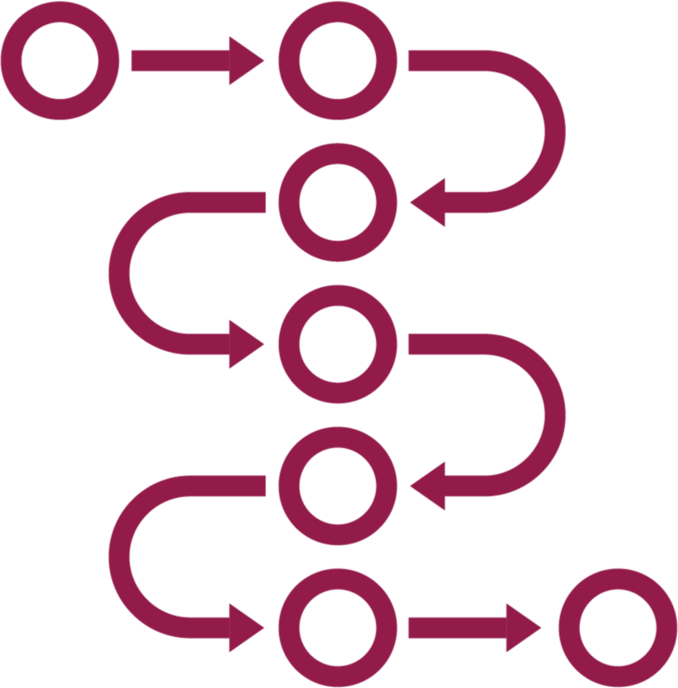

The Role of Asynchronous Processing in Microservices
Reduce dependencies between services
Support low latency, high throughput scenarios
Facilitate event- driven computing

Slide 4

Problems with the Status Quo
Consuming resources when services aren’t in
use
Services get baked into monolithic applications that are hard to deploy
Challenges scaling when demand spikes Routing details intermixed with business logic

Slide 5
What Exactly Is “Serverless” Computing?
“Managed services that scale to zero”
Function-as-a-service is serverless computing
Elastic, auto-scaled services
Start up fast, run for short periods

Slide 6
Spring Cloud Function
Short-lived, asynchronous microservices.

Slide 7



How This Fits Into the Spring Ecosystem
Spring Cloud Function apps are powered by Spring Boot
Relies on Project Reactor for reactive APIs
Used in other projects like Spring Cloud Stream

Slide 8




Creating a Function
Add dependent packages
Choose functional interface to use
Add business logic to your function
Annotate as @bean

Slide 9

How Does a Function’s Logic Work?
Spring Boot apps with access to auto- configuration, and more
Function can be treated as if stateless, but it depends on where/how deployed
May accept parameters and return values based on functional interface chosen

Slide 10

Demo
Create a new Spring Boot project for Toll Processing function
Define the function’s interface and
annotate
Add function’s logic for retrieving toll
station data
Execute function via web request

Slide 11
Choose From Three Functional Interfaces
Supplier<O>
Consumer<I>
Function<I, O>
Use for endpoints that provide data without input
Use for asynchronous endpoints that take input and expect no output
Use for request- response endpoints

Slide 12
@Bean
public Supplier<String> supplyName() {
return () -> ”Walt";
}
@Bean
public Supplier<List<String>> supplyNames() { List<String> names = new ArrayList<>(); names.add(”Walt");
names.add(”Vic");
return () -> names;
}
The Supplier Interface - Imperative
This interface returns data and would respond to an HTTP GET request

Slide 13
@Bean
public Supplier<Flux<String>> supplyNamesReactive() { ArrayList<String> names = new ArrayList<String>(); names.add("Ferg");
names.add("Ruby");
names.add("Henry");
//sends all messages back
return () -> Flux.fromIterable(names);
}
The Supplier Interface - Reactive
This interface returns a data stream and would respond to an HTTP GET request

Slide 14
@Bean
public Consumer<String> consumeName() {
return value -> {
System.out.println("received message - " + value);
};
}
@Bean
public Consumer<List<String>> consumeNames() {
return value -> {
value.forEach(v -> System.out.println(v));
};
}
The Consumer Interface - Imperative
This interface provides data and would respond to an HTTP POST request

Slide 15
@Bean
public Consumer<Flux<String>> consumeNamesReactive() {
return value -> { value.subscribe(System.out::println);
};
}
The Consumer Interface - Reactive
This interface provides a data stream and would respond to an HTTP POST request

Slide 16
@Bean
public Function<String, String> processName() {
return value -> "Hello, " + value;
}
@Bean
public Function<List<String>, String> processNames() {
//process first value
return value -> "Hello, " + value.get(0);
}
The Function Interface - Imperative
This interface accepts and returns data and would respond to an HTTP POST or GET request

Slide 17
@Bean
public Function<Flux<String>, Flux<String>> processNamesReactive() {
return flux -> flux.map(value -> value.toUpperCase());
}
The Function Interface - Reactive
This interface accepts and returns data streams and would respond to an HTTP POST or GET request

Slide 18
Demo
Add a function to existing app that receives new toll payment information
Experiment with each Function interface type to observe how data is processed

Slide 19
Deploying Your Functions
Embed in standalone web application
Embed in standalone streaming application
Import as packaged function in JAR(s)

Slide 20

Using Serverless Platform Adapters
Run in public cloud function-as-a-service platforms
Built-in and community adapters
Adapters help with entry points, isolation from specifics of each platform API
Minimize size, complexity, and local state of functions in a FaaS platform

Slide 21
The rise of asynchronous processing in microservices
Summary
The problem with the status quo
What serverless computing is about Understanding Spring Cloud Function Creating functions
Understanding the function interfaces Deploying functions

